Slide 1

Get the music you need.

Slide 2
What is it?
A combo of music content and technical product.
Target:
Music lovers, ages of 18-27, who like discovering and consuming new music
Music creators, who look to write commercial music and develop music career
Product:
Curated articles & user generated content
Customized analytic dashboard

Slide 3
Why it is potential?
Young people who look to discover new music accounts for 70% of dollars spent on music (including music subscriptions, downloads, and concerts).
A lot of music songwriters and producers always feel confused about how to make a hit song and how no way to efficiently find music trendsetters.
Our Opportunity: Integrated better solution.
From Radio, TV, words of moths, YouTube, social media, on-demand streaming, music blog, concerts.
To integrated source from editorial team and resourceful users
From Blogs How to Make a Hit Song, Data of streams and views, music charts
To accessible music trendsetters supported by real-time data analytics

Slide 4

Technology & Tools
-Website adapted for mobile
-Social media
-Email Marketing
-Personal branding
-Education Videos
-Google Analytics
Facebook post sample

Slide 5
How to acquire new audience
Content & Product
Delicate modern articles, exclusive data analytics
Social functionalities
Build up awareness
Text oriented social media: Facebook, Twitter, Tumblr
Native and display ads
Partnership(with Spotify, Apple Music, Google Play and Amazon Prime)
Easy log on
Enticing hardware: Apple HomePod, Google Home, Amazon Alexa

Slide 6
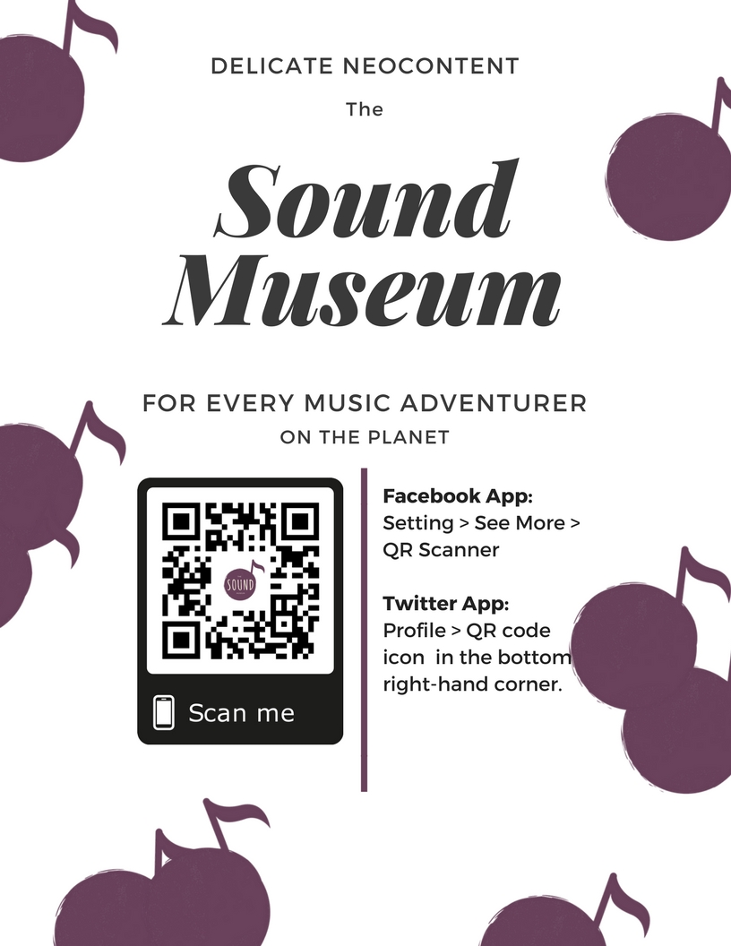
What we get so far
Social Media Ads
High engagement rate 5%
High potential conversion rate: 17.9% (7 views/39 reaches)
High promoter score

Slide 7
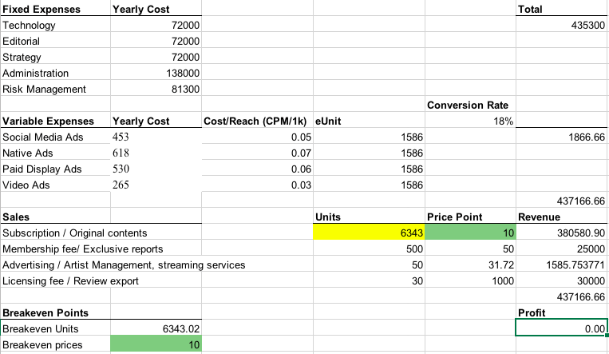
Financial Plan (break-even)
Time: 1 year
Subscription fee $10
Break-even Users:
6334

Slide 8
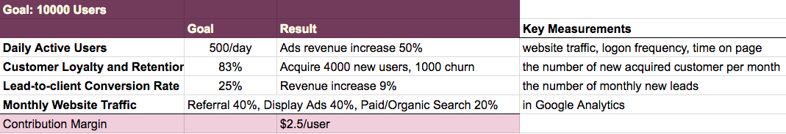
Business Metrics
Projected business performance

Slide 9
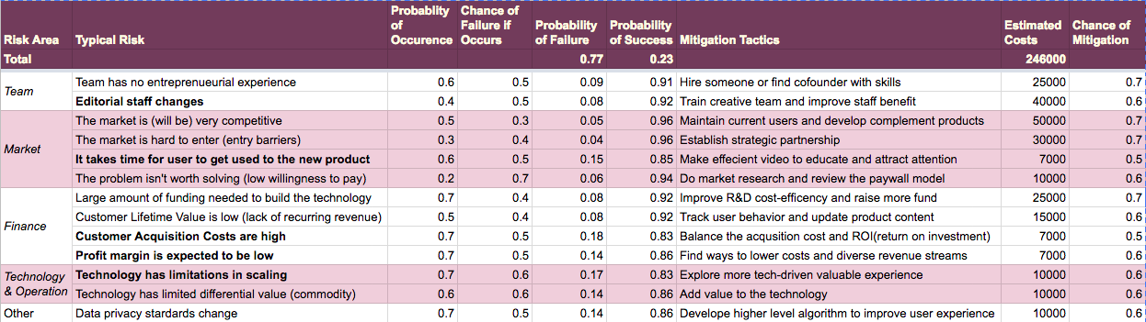
Risk Assessment
Rate = Failure * Occurrence (1 - Mitigation)
Notes:
What you've learned about what does or doesn't work. Risks and how you'll
overcome them, or pivots or improvements you’ve made.

Slide 10
Q&A
Thank you!

